Slide 1
Unit-1
Fundamental of Programming in Java

Slide 2
Contents
History of Java, Basic overview of java, Bytecode, JVM
Buzz-words, Application and applets
Constants, Variables & Data Types, Comment
Operators and control flow

Slide 3
What is Java
Java is a programming language and a platform.
The Java programming language is a high-level language that can be characterized by all of the following buzzwords:
Simple Object oriented Distributed Multithreaded Dynamic | Architecture neutral Portable High performance Robust Secure

Slide 4
1. Simple
Java is very easy to learn and its syntax is simple, clean and easy to understand.
Java has removed many confusing and rarely-used features e.g. explicit pointers, operator overloading etc.
There is no need to remove unreferenced objects because there is Automatic Garbage Collection in java.

Slide 5
2. Object-oriented
Object-oriented means we organize our software as a combination of different types of objects that incorporates both data and behavior.
Basic concepts of OOPs are:
Object
Class
Inheritance
Polymorphism
Abstraction
Encapsulation

Slide 6
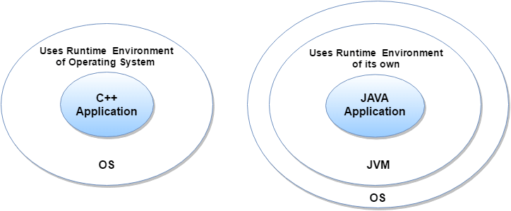
3. Secured
Java is secured because:
No explicit pointer
Java Programs run inside virtual machine sandbox

Slide 7
Classloader:
Classloader in Java is a part of the Java Runtime Environment(JRE) which is used to dynamically load Java classes into the Java Virtual Machine.
It adds security by separating the package for the classes of the local file system from those that are imported from network sources.
Bytecode Verifier:
It checks the code fragments for illegal code that can violate access right to objects.
Security Manager:
It determines what resources a class can access such as reading and writing to the local disk.

Slide 8
4. Robust
Robust simply means strong.
Java is robust because:
It uses strong memory management.
There are lack of pointers that avoids security problems.
There is automatic garbage collection in java
There is exception handling and type checking mechanism in java.

Slide 9
5. Architecture-neutral
Java is architecture neutral because there is no implementation dependent features
e.g. size of primitive types is fixed.
In C programming, int data type occupies 2 bytes of memory for 32-bit architecture and 4 bytes of memory for 64-bit architecture. But in java, it occupies 4 bytes of memory for both 32 and 64 bit architectures.

Slide 10
6. Portable:
Java is portable because it facilitates you to carry the java bytecode to any platform.
7. High-performance :
Java is faster than other traditional interpreted programming languages because Java bytecode is "close" to native code.
8. Distributed
Java is distributed because it facilitates users to create distributed applications in java.
RMI and EJB are used for creating distributed applications.

Slide 11
9. Multi-threaded
A thread is like a separate program, executing concurrently.
The main advantage of multi-threading is that it doesn't occupy memory for each thread. It shares a common memory area.
Threads are important for multi-media, Web applications etc.
10. Dynamic
Java is a dynamic language. It supports dynamic loading of classes. It means classes are loaded on demand.

Slide 12
An overview of the software development process.
All source code is first written in plain text files ending with the .java extension.
source files are then compiled into .class files by the javac compiler.
A .class file does not contain code that is native to your processor; it instead contains bytecodes — the machine language of the Java Virtual Machine1 (Java VM).

Slide 13
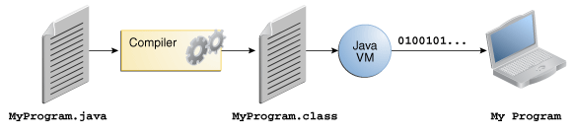
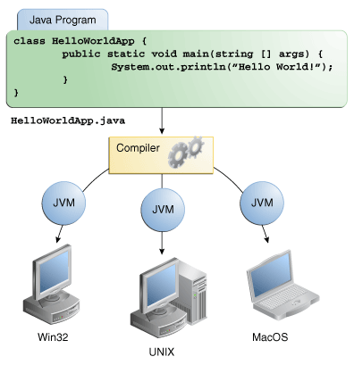

Slide 14
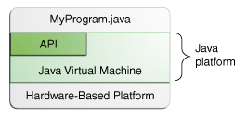
The Java Platform
The Java platform has two components:
The Java Virtual Machine
The Java Application Programming Interface (API)

Slide 15
Where Java is used?
Desktop Applications such as acrobat reader, media player, antivirus etc.
Web Applications such as irctc.co.in,
Enterprise Applications such as banking applications.
Mobile
Embedded System
Smart Card
Robotics
Games

Slide 16
Types of Java Applications
Types | Examples
Standalone Application | Media player, antivirus etc. AWT and Swing are used in java for creating standalone applications.
Web Application | Servlet, JSP, Struts, Spring, Hibernate, JSF etc
Enterprise Application | banking applications, EJB is used for creating enterprise applications.
Mobile Application | Android and Java ME

Slide 17
Java Editions
Edition | Purpose
Java SE (Java Standard Edition) | Java programming APIs such as java.lang, java.io, java.net, java.util, java.sql, java.math core topics like OOPs, String, Regex, Exception, Inner classes, Multithreading, I/O Stream, Networking, AWT, Swing, Reflection, Collection etc.
Java EE (Java Enterprise Edition) | enterprise platform which is mainly used to develop web and enterprise applications. It is built on the top of Java SE platform. It includes topics like Servlet, JSP, Web Services, EJB, JPA etc.
Java ME (Java Micro Edition) | It is a micro platform which is mainly used to develop mobile applications
JavaFx | It is used to develop rich internet applications. It uses light-weight user interface API.

Slide 18
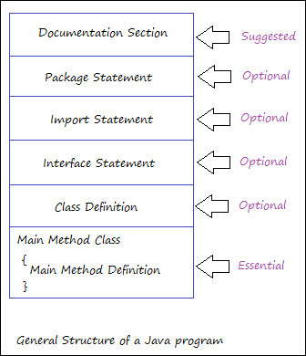
Java Program structure

Slide 19
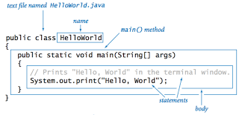

Slide 20
Application and applets
Applet:
A program designed to be executed from within another application.
Unlike an application, applets cannot be executed directly from the operating system.
Web browsers, which are often equipped with Java virtual machines, can interpret applets from Web servers.
Because applets are small in files size, cross-platform compatible, and highly secure (can't be used to access users' hard drives), they are ideal for small Internet applications accessible from a browser.

Slide 21
BASIS FOR COMPARISON | APPLET | APPLICATION
Basic | It is small program uses another application program for its execution. | An application is the programs executed on the computer independently.
main() method | Do not use the main method | Uses the main method for execution
Execution | Cannot run independently require API's (Ex. Web API). | Can run alone but require JRE.
Installation | Prior installation is not needed | Requires prior explicit installation on the local computer.
Read and write operation | The files cannot be read and write on the local computer through applet. | Applications are capable of performing those operations to the files on the local computer.
Communication with other servers | Cannot communicate with other servers. | Communication with other servers is probably possible.
Restrictions | Applets cannot access files residing on the local computer. | Can access any data or file available on the system.
Security | Requires security for the system as they are untrusted. | No security concerns are there.

Slide 22
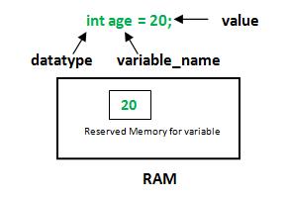
Constants, Variables & Data Types, Comment
An object stores its state in fields.
float simpleInterest; //Declaring float variable
int time = 10, speed = 20; //Declaring and Initializing integer variable
char var = 'h'; // Declaring and Initializing character variable

Slide 23
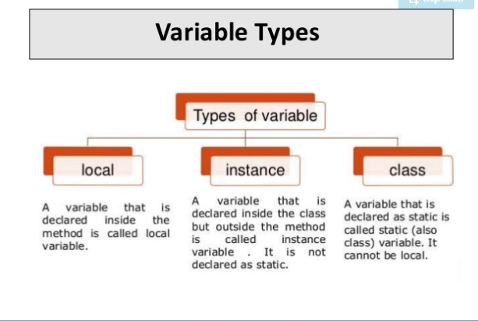

Slide 24
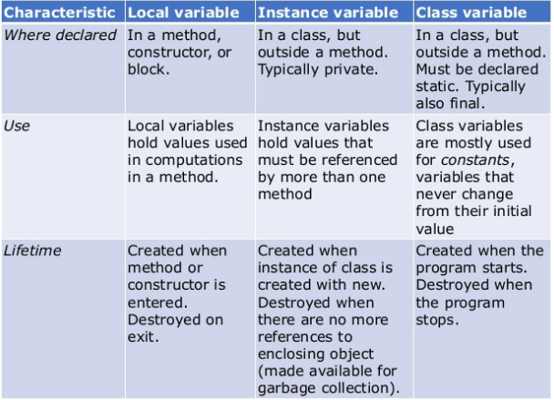

Slide 25
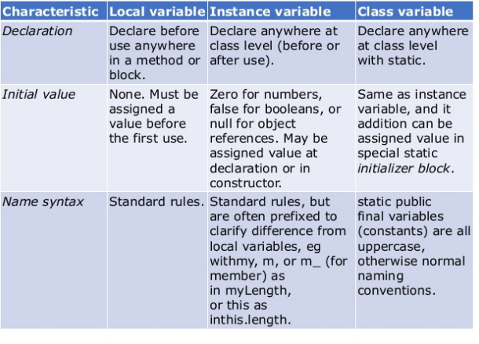

Slide 26
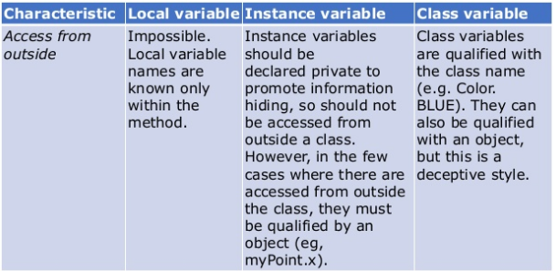

Slide 27
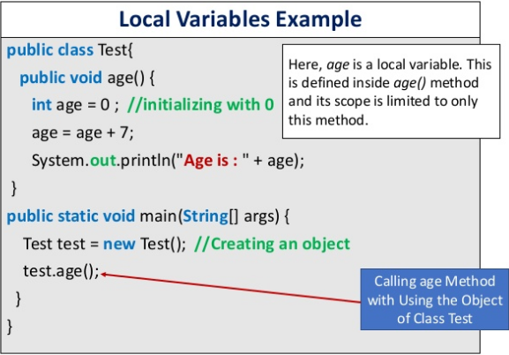

Slide 28
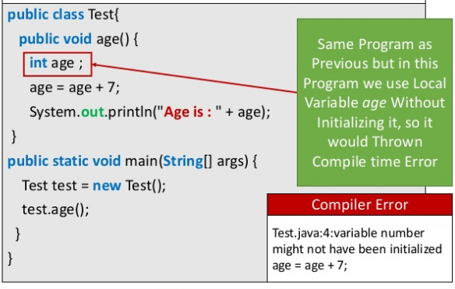

Slide 29
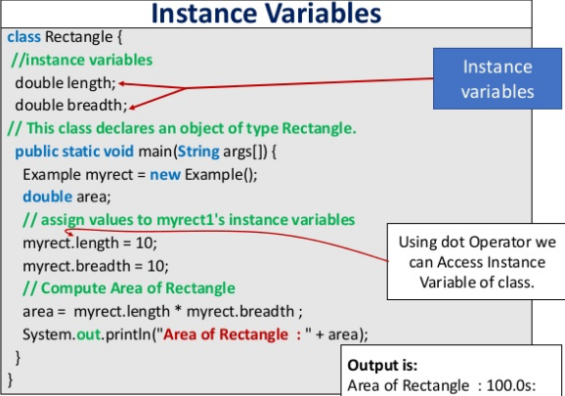

Slide 30
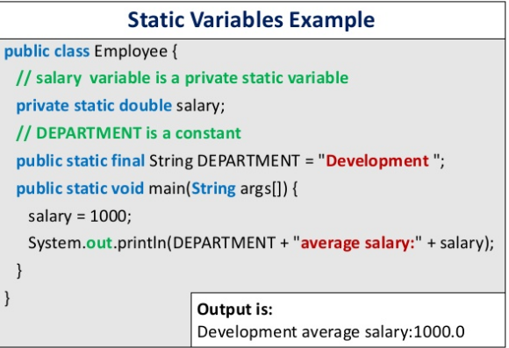

Slide 31
Data types
Java is statically typed and also a strongly typed language :
Statically typed language ,where each variable and expression type is already known at compile time.
Every variable has a type, every expression has a type, and every type is strictly defined.
all assignments, whether explicit or via parameter passing in method calls, are checked for type compatibility.

Slide 32
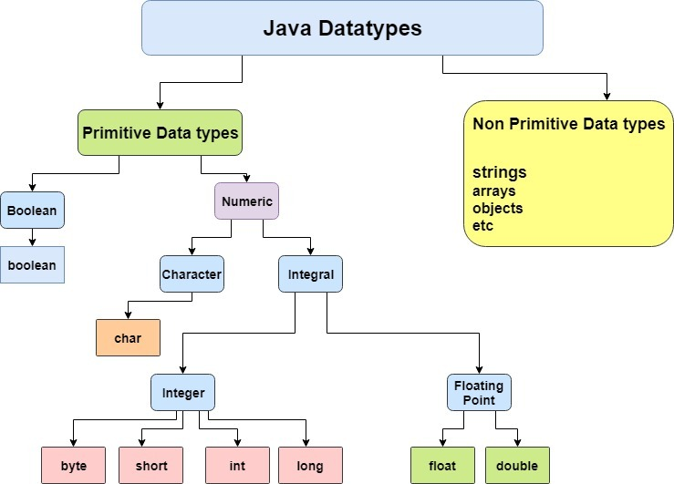

Slide 33
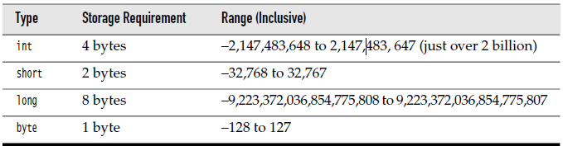
Java Integer Types

Slide 34
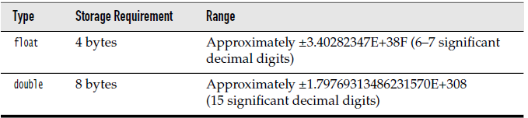
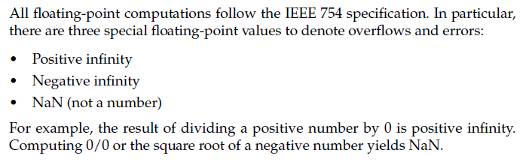
Floating point Types

Slide 35
The char type
It stores character constants in the memory.
It assumes a size of 2 bytes, but basically it can hold only a single character because char stores unicode character sets.
It has a minimum value of ‘u0000’ (or 0) and a maximum value of ‘uffff’ (or 65,535, inclusive).
The boolean type:
Boolean data types are used to store values with two states: true or false.

Slide 36
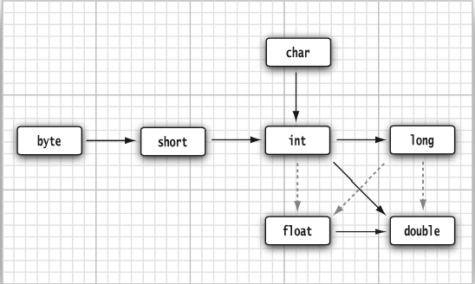
Conversion between Numeric types
No loss of data
Loss of data

Slide 37
Comments
Comments are ignored by the compiler while compiling a code.
In Java there are three types of comments:
Single – line comments.
Multi – line comments.
Documentation comments.
This type of comments are used generally when writing code for a project/software package, since it helps to generate a documentation page for reference, which can be used for getting information about methods present, its parameters, etc.
Example : @author,@exception

Slide 38
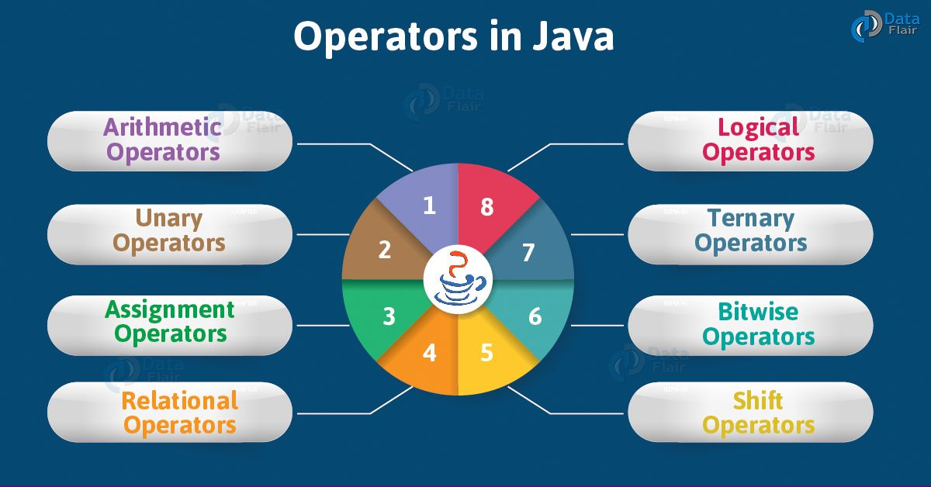

Slide 39
Category | Operators
Simple assignment | =
Arithmetic | + - * / %
Unary | + - ++ -- !
Relational | == != > >= < <=
Logical and Conditional | && || ? : (ternary)
Type comparison | instanceof
Bitwise and Bit shift | ~ << >> >>> & ^ |

Slide 40
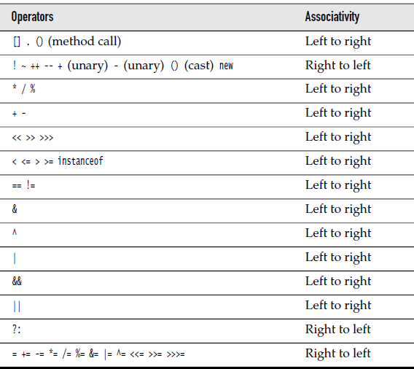
Operator precedence

Slide 41
Control-Flow
Types of Java Loops | Syntax
While loop | while (boolean condition) { loop statements... }
For-loop | for (initialization condition; testing condition; increment/decrement) { statement(s) }
Do-while loop | do { statements.. } while (condition);

Slide 42
Control-flow
Name | Syntax
if-then | if(boolean expressio) { //statements }
If-then-else | If(boolean expression) { //statements } Else { //statements }
Switch | Switch(expression) { Case 1://statements Break; …. … Default://statements }

Slide 43
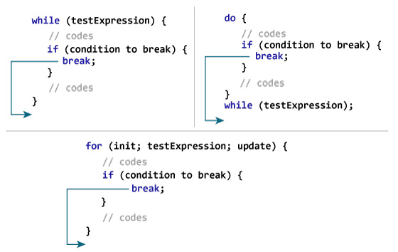
break statement

Slide 44
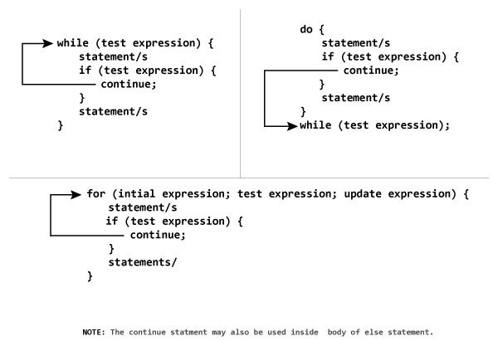
continue statement

Slide 45
Exercise on Variables
The term "instance variable" is another name for ___.
The term "class variable" is another name for ___.
A local variable stores temporary state; it is declared inside a ___.
A variable declared within the opening and closing parenthesis of a method signature is called a ____.
What are the eight primitive data types supported by the Java programming language?
Character strings are represented by the class ___.
An ___ is a container object that holds a fixed number of values of a single type.

Slide 46
Answers
The term "instance variable" is another name for non-static field.
The term "class variable" is another name for static field.
A local variable stores temporary state; it is declared inside a method.
A variable declared within the opening and closing parenthesis of a method is called a parameter.
What are the eight primitive data types supported by the Java programming language? byte, short, int, long, float, double, boolean, char
Character strings are represented by the class java.lang.String.
An array is a container object that holds a fixed number of values of a single type.

Slide 47
Lab Exercise
Create a small program that defines some fields. Try creating some illegal field names and see what kind of error the compiler produces. Use the naming rules and conventions as a guide.
In the program you created in Exercise 1, try leaving the fields uninitialized and print out their values. Try the same with a local variable and see what kind of compiler errors you can produce. Becoming familiar with common compiler errors will make it easier to recognize bugs in your code.

Slide 48
Exercise on operators
Consider the following code snippet.
arrayOfInts[j] > arrayOfInts[j+1]
Which operators does the code contain?
Consider the following code snippet.
int i = 10; int n = i++%5;
a. What are the values of i and n after the code is executed?
b. What are the final values of i and n if instead of using the postfix increment operator (i++), you use the prefix version (++i))?
To invert the value of a boolean, which operator would you use?
Which operator is used to compare two values, = or == ?
Explain the following code sample:
result = someCondition ? value1 : value2;

Slide 49
Answers
1. >, +
2. a. i is 11, and n is 0. b. i is 11, and n is 1
3. The logical complement operator "!"
4. The == operator is used for comparison, and = is used for assignment.
5. "If someCondition is true, assign the value of value1 to result. Otherwise, assign the value of value2 to result."

Slide 50
Exercise on control flow statements
The ___ statement allows for any number of possible execution paths.
The ___ statement is similar to the while statement, but evaluates its expression at the ___ of the loop.
How do you write an infinite loop using the for statement?
How do you write an infinite loop using the while statement?

Slide 51
Answers
1. switch
2. do-while, bottom
3. for ( ; ; ) { }
4. while (true) { }

